Slide 1
Evolutionary Algorithms for selecting the architecture of a MLP Neural Network: A Credit Scoring Case
Alejandro Correa - Andres Gonzalez
Banco Colpatria
Bogota, Colombia

Slide 2
Agenda
About Colpatria
The Problem
Solution
Results
On-Going Applications

Slide 3
Colpatria Bank
Bank establish in 1955
Over 1.5 MM Credit Cards
# 1 Colombian bank in # of CC
# 5 Colombian bank in $ of assets
Average Credit Card limit 1500 USD
Serve to low-mid income colombians
JV with GE Capital (December 2006 – July 2011)
Recently purchased by Scotia-Bank (October 2011)

Slide 4
Problem
Increasing delinquency
Highest CC delinquency in the sector
Bad performance of Logistic Regression scorecards
Small time window to construct models

Slide 5
Problem

Slide 6
Problem

Slide 7
Solution
Develop an algorithm that selects the MLP Neural Network architecture that maximizes the ROC statistics in a reasonable time
Binary Particle Swarm Optimization and Binary Genetic Algorithms

Slide 8
Solution
Data Set
Neural Network
Final Model
Optimization Algorithm

Slide 9
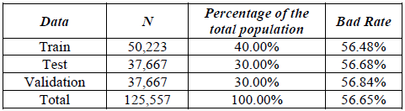
Results
Credit Card Acquisition Model
Predict the probability of a new client defaulting over the next 12 months
Data Used

Slide 10
Results
Models Comparison

Slide 11
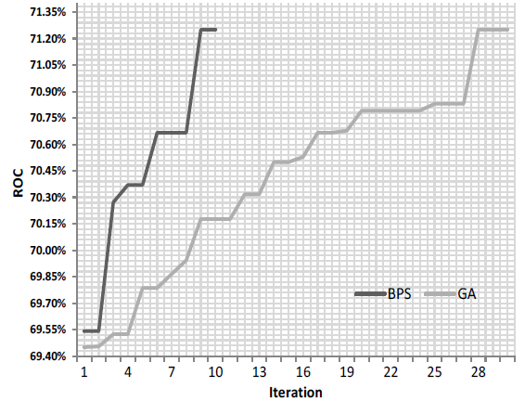
Results

Slide 12
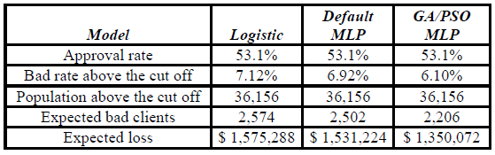
Results
Economic Analysis
Annual savings vs Logistic Regression $225,216

Slide 13
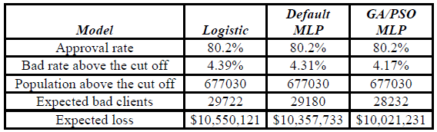
On-Going Applications
Behavior Model
Predict the probability of a client defaulting over the next 12 months
Economic Analysis
Annual savings vs Logistic Regression $528,890

Slide 14
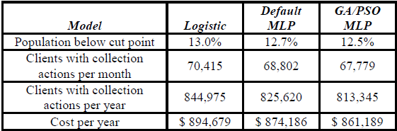
On-Going Applications
Collection Model
Predict the probability of a client paying his next monthly installment
Economic Analysis
Annual savings vs Logistic Regression $33,490

Slide 15
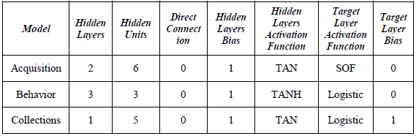
Final Insight
Models Neural Network Architecture
Architecture change very much between models

Slide 16
Contact Info
Alejandro Correa Bahnsen
Banco Colpatria
Bogotá, Colombia
(+57) 3208306606
al.bahnsen@gmail.com
Andrés González
Banco Colpatria
Bogotá, Colombia
(+57) 3103595239
gonzalean@colpatria.com

